Slide 1

Graphs

Slide 2
Degree of a vertex
Definition 1. The degree of a vertex in an undirected graph is the number of edges incident with it, except that a loop at a vertex contributes twice to the degree of that vertex.
c
d
deg( d ) = 1
b
a
g
f
e

Slide 3
Degree of a vertex
Degree of a vertex
Definition 1. The degree of a vertex in an undirected graph is the number of edges incident with it, except that a loop at a vertex contributes twice to the degree of that vertex.
c
d
b
deg( e ) = 0
a
g
f
e

Slide 4
Degree of a vertex
Degree of a vertex
Definition 1. The degree of a vertex in an undirected graph is the number of edges incident with it, except that a loop at a vertex contributes twice to the degree of that vertex.
c
d
deg( b ) = 6
b
a
g
f
e

Slide 5
Degree of a vertex
Degree of a vertex
Find the degree of all the other vertices.
deg( a ) deg( c ) deg( f ) deg( g )
c
d
deg( b ) = 6
deg( d ) = 1
b
deg( e ) = 0
a
g
f
e

Slide 6
Degree of a vertex
Degree of a vertex
Find the degree of all the other vertices.
deg( a ) = 2 deg( c ) = 4 deg( f ) = 3 deg( g ) = 4
c
d
deg( b ) = 6
deg( d ) = 1
b
deg( e ) = 0
a
g
f
e

Slide 7
Degree of a vertex
Degree of a vertex
Find the degree of all the other vertices.
deg( a ) = 2 deg( c ) = 4 deg( f ) = 3 deg( g ) = 4
TOTAL of degrees = 2 + 4 + 3 + 4 + 6 + 1 + 0 = 20
c
d
deg( b ) = 6
deg( d ) = 1
b
deg( e ) = 0
a
g
f
e

Slide 8
Degree of a vertex
Degree of a vertex
Find the degree of all the other vertices.
deg( a ) = 2 deg( c ) = 4 deg( f ) = 3 deg( g ) = 4
TOTAL of degrees = 2 + 4 + 3 + 4 + 6 + 1 + 0 = 20
TOTAL NUMBER OF EDGES = 10
c
d
deg( b ) = 6
deg( d ) = 1
b
deg( e ) = 0
a
g
f
e

Slide 9
Handshaking Theorem
Theorem 1. Let G = (V, E) be an undirected graph G with e edges. Then
∑ deg( v ) = 2 e
v ε V
“The sum of the degrees over all the vertices equals twice the number of edges.”
NOTE: This applies even if multiple edges and loops are present.

Slide 10
Some Special Simple Graphs : Complete Graphs - Kn
Complete Graphs - K_{n}
A complete graph on n vertices, denoted by K_{n}, is a simple graph that contains exactly one edge between each pair of distinct vertices.
No. of Edges = n(n-1) / 2

Slide 11
Graph Patterns Complete Graphs - Kn
Complete Graphs – K_{n ,} when n = 1, 2, 3, 4, 5
K₁ K₂ K₃ K₄ K₅

Slide 12
Some Special Simple Graphs : Cycles - Cn
Cycles - C_{n}
A cycle C_{n}, n ≥ 3, consists of n vertices v₁, v₂, ….., v_{n} and edges {v₁, v₂},
{v₂, v₃}, ..., {v_{n}−1, v_{n}}, and {v_{n}, v₁}.
No. of Edges = n

Slide 13
Graph Patterns Cycles - Cn
C₃ C₄ C₅
Cycle Graphs – C_{n ,} when n = 3, 4, 5

Slide 14
Some Special Simple Graphs : Wheel Graph
Wheel Graph
We obtain a wheel W_{n} when we add an additional vertex to a cycle C_{n}, for n ≥ 3, and connect this new vertex to each of the n vertices in C_{n}, by new edges.

Slide 15
Graph Patterns Wheels - Wn
W_{n ;} n = 3, 4, 5
W₃ W₄ W₅
.

Slide 16
Some Special Simple Graphs : Cubes - Qn
Cubes - Q_{n}
Q₀ Q₁ Q₂ Q₃ Q₄ (hypercube)
The n-cube Q_{n} is defined recursively. Q₀ is just a vertex. Q_{n+1} is gotten by taking 2 copies of Q_{n} and joining each vertex v of Q_{n} with its copy v’ :

Slide 17
Some Special Simple Graphs
Cubes - Q_{n}
Q₀ Q₁ Q₂ Q₃ Q₄ (hypercube)
The n-cube Q_{n} is defined recursively. Q₀ is just a vertex. Q_{n+1} is gotten by taking 2 copies of Q_{n} and joining each vertex v of Q_{n} with its copy v’ :

Slide 18
Some Special Simple Graphs
Cubes - Q_{n}
Q₀ Q₁ Q₂ Q₃ Q₄ (hypercube)
The n-cube Q_{n} is defined recursively. Q₀ is just a vertex. Q_{n+1} is gotten by taking 2 copies of Q_{n} and joining each vertex v of Q_{n} with its copy v’ :

Slide 19
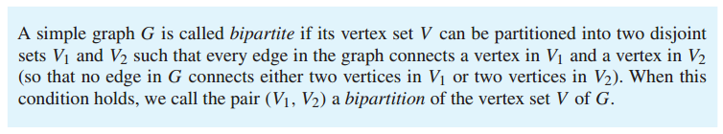
Bipartite Graphs
Definition

Slide 20
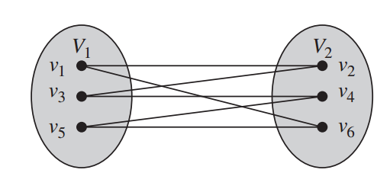
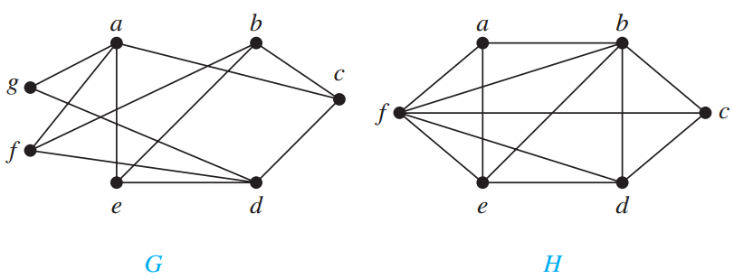
Is Bipartite Graphs?
Notes:
G bipartite, because v1(a,b,d) and v2(g,f,e,c) H is not

Slide 21

Bipartite Graphs
Another definition

Slide 22
Graph Patterns Complete Bipartite - Km,n
When all possible edges exist in a simple bipartite graph with m red vertices and n green vertices, the graph is called complete bipartite and the notation K_{m,n} is used. EG:
K_{2,3} K_{4,5}

Slide 23
Adjacency Matrix
A simple graph G = (V, E) with n vertices
can be represented by its adjacency matrix,
A, where entry a_{ij} in row i and column j is
1 if { v_{i}, v_{j} } is an edge in G,
a_{ij} =
0 otherwise.

Slide 24
Finding the adjacency matrix
c
c
This graph has 6 vertices a, b, c, d, e, f. We can arrange them in that order.
b
d
f
a
a
e
e
W₅

Slide 25
Finding the adjacency matrix
Finding the adjacency matrix
TO
a b c d e f
c
c
FROM
a 0 1 0 0 1 1
b
c
d
e
f
b
d
f
a
a
e
e
W₅
There are edges from a to b, from a to e, and from a to f

Slide 26
Finding the adjacency matrix
Finding the adjacency matrix
TO
a b c d e f
c
c
FROM
a 0 1 0 0 1 1
b 1 0 1 0 0 1
c
d
e
f
b
d
f
a
a
e
e
W₅
There are edges from b to a, from b to c, and from b to f

Slide 27
Finding the adjacency matrix
Finding the adjacency matrix
TO
a b c d e f
c
c
FROM
a 0 1 0 0 1 1
b 1 0 1 0 0 1
c 0 1 0 1 0 1
d
e
f
b
d
f
a
a
e
e
W₅
There are edges from c to b, from c to d, and from c to f

Slide 28
Finding the adjacency matrix
Finding the adjacency matrix
TO
a b c d e f
c
c
FROM
a 0 1 0 0 1 1
b 1 0 1 0 0 1
c 0 1 0 1 0 1
d
e
f
b
d
f
a
a
e
e
W₅
COMPLETE THE ADJACENCY MATRIX . . .

Slide 29
Finding the adjacency matrix
Finding the adjacency matrix
TO
a b c d e f
c
c
FROM
a 0 1 0 0 1 1
b 1 0 1 0 0 1
c 0 1 0 1 0 1
d 0 0 1 0 1 1
e 1 0 0 1 0 1
f 1 1 1 1 1 0
b
d
f
a
a
e
e
W₅
Notice that this matrix is symmetric. That is a_{ij} = a_{ji}

Slide 30
Any Questions?

